Slide 1
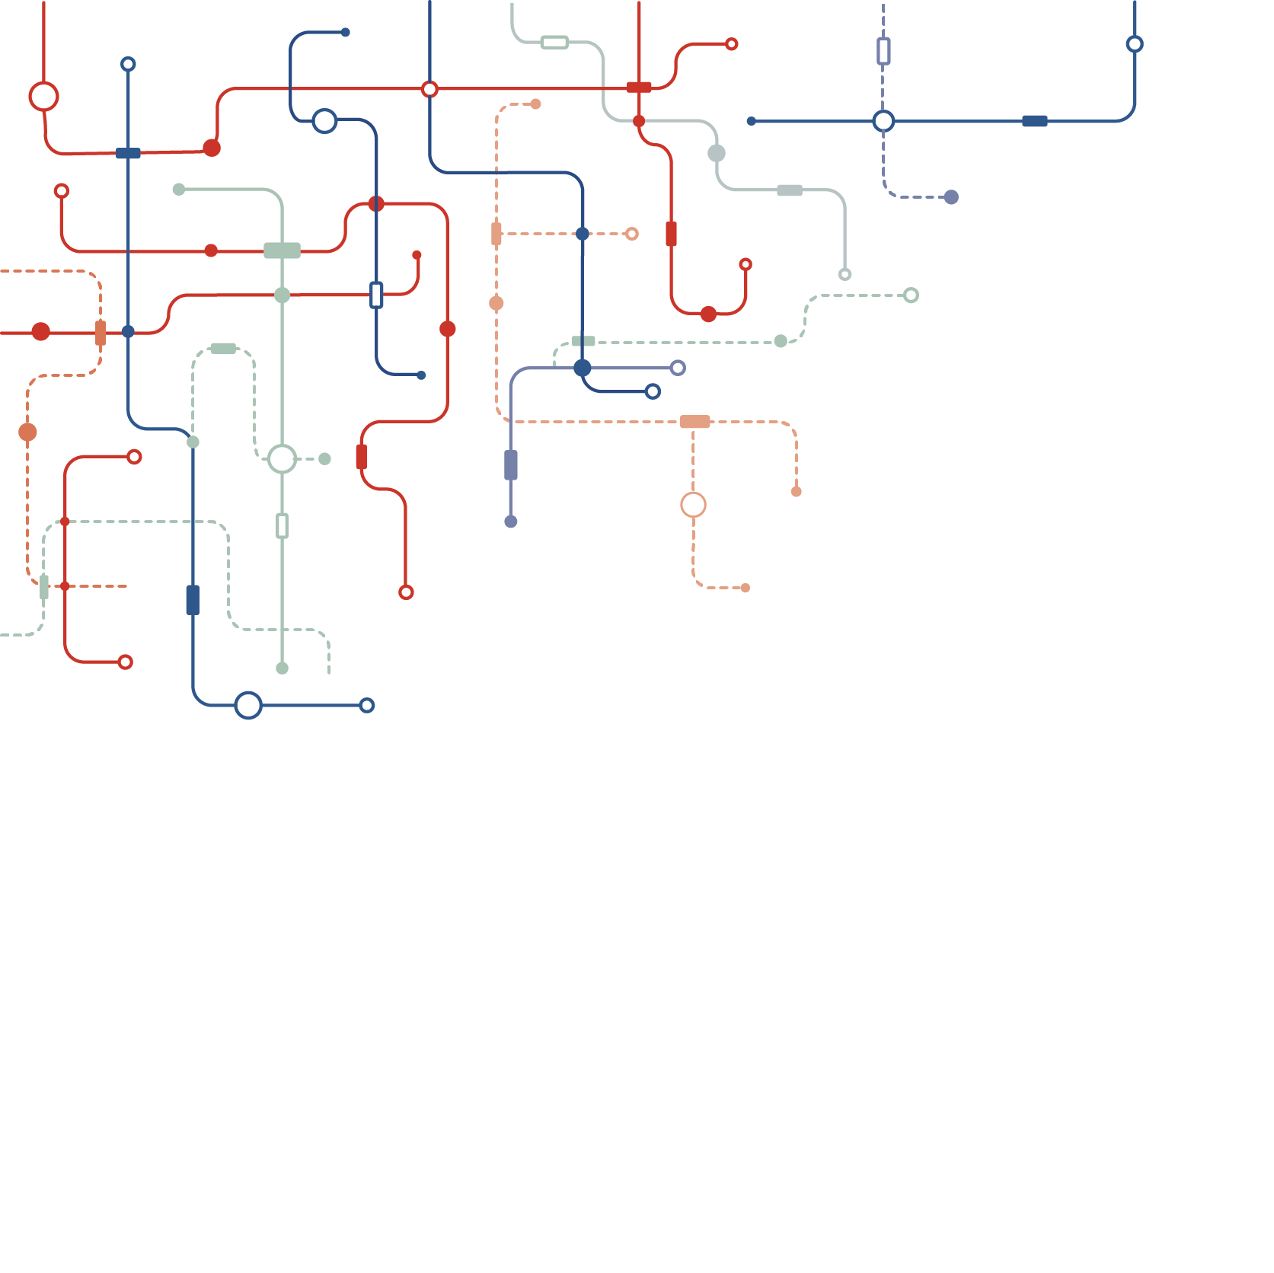
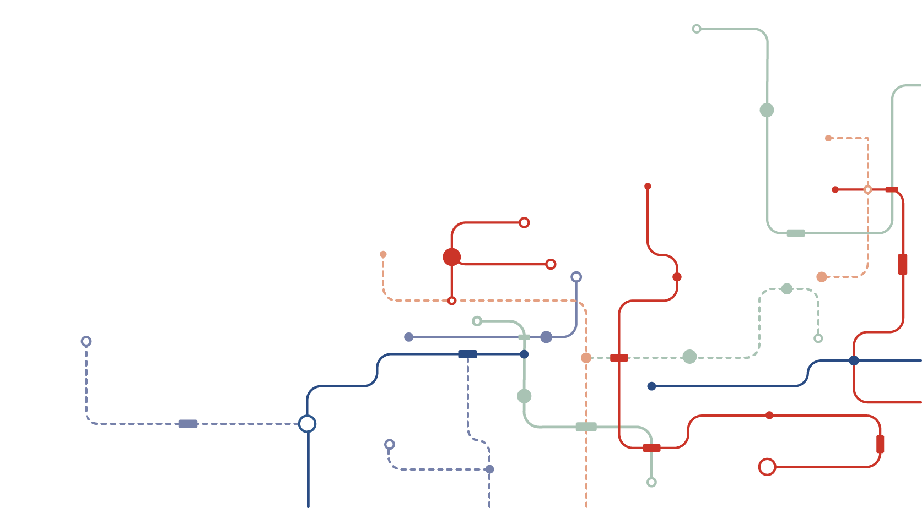

2021
Maricopa County – Risk Management
Safety submit
Data Analyst
Zixiang Michael Jin
2/24/2021

Slide 2
Index
1
Osha KPIs
2
Data Project
3
Example: Covid-19 Command Center
4
Summary

Slide 3

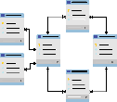
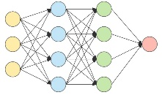
1
Data Engineer
2
Build data pipelines to stream data across platforms so that data from different department are comparable to each other.
3
Data Analyst
Based on the data infrastructure created by engineer, data analyst then design database, reporting system, and define KPI (Key Performance Indicator)
Data Scientist
Apply cutting-edge modeling for predicting, such as regression, Decision-Tree and Neuro network.

Slide 4
Part 1
Osha KPIs
OSHA Key Performance Indicator is used to measure how many incidents have occurred, or how severe they were.
OSHA has established specific mathematic calculations that enable any company to not only monitor their own performance, but they are comparable across any department, division or group.

Slide 5

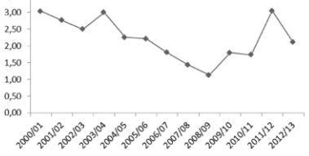

Osha KPI
Severity Rate
Incident Rate
Lost Workday Rate
A mathematical calculation that describes the number of lost days experienced as compared to the number of incidents experienced.
The is calculated by multiplying the number of recordable cases by 200,000, and then dividing that number by the number of labor hours at the company.
A mathematical calculation that describes the number of lost workdays per 100 full-time employees in any given time frame.

Slide 6
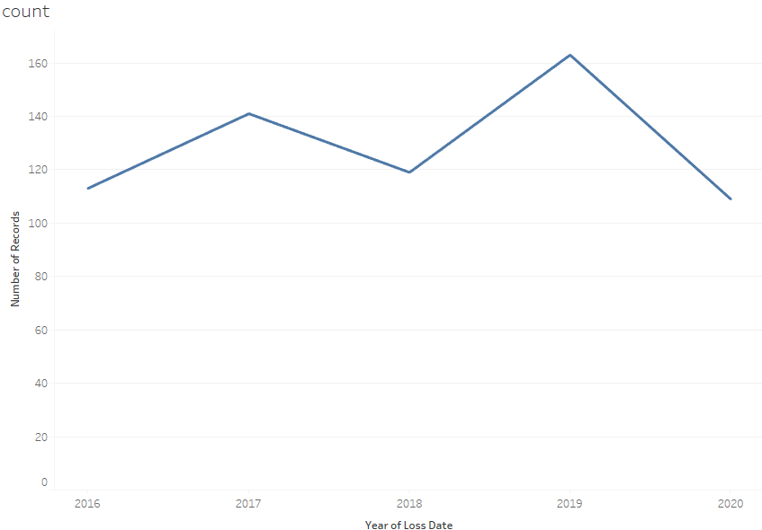
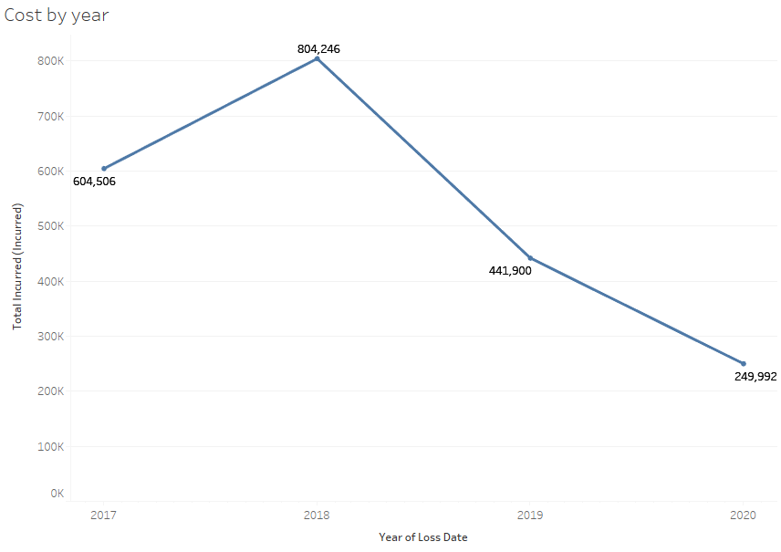
Osha KPI
Number of Accidents by Year
Average Accident Cost by Year
1

Slide 7
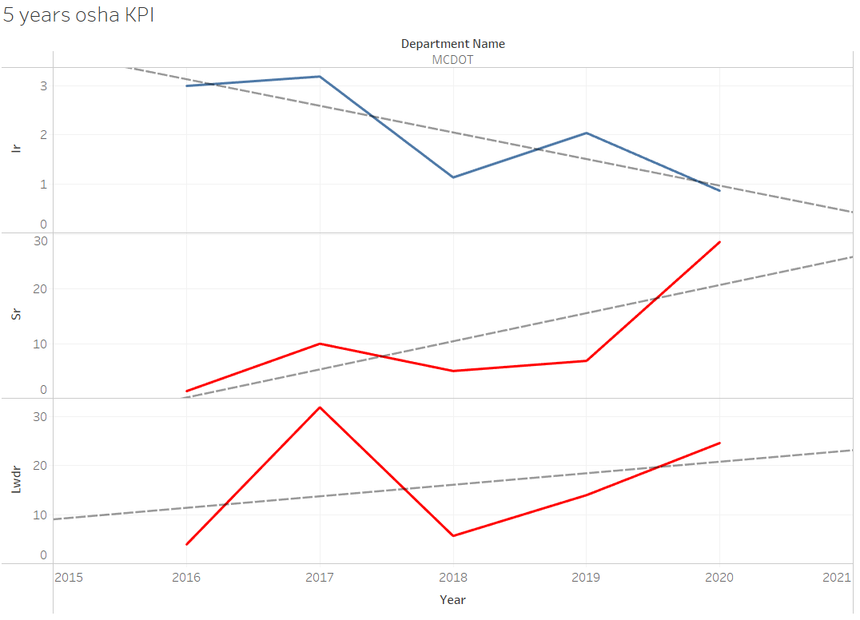
Osha KPI
Incident Rate is going down
1
Severity Rate and Lost Workday Rate is going up
2

Slide 8
Osha KPI
OSHA KPI
KPI
Osha KPIs have been standardized, so that managers can compare statistically significant KPIs with other department or with their own past safety performance. Osha KPIs will help managers to determine where his department may need additional program assistance in order to prevent accidents from happening again.
Accident
Strategy

Slide 9
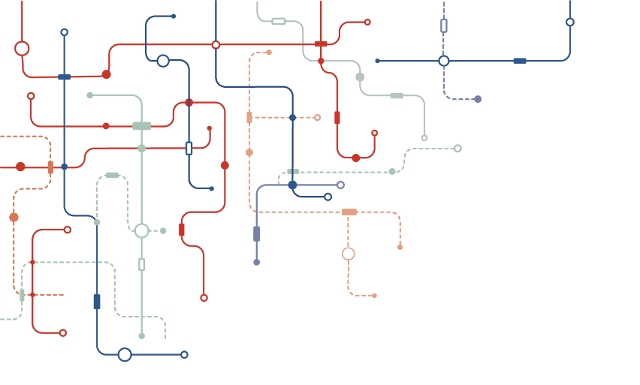
Part 2
Data Project
Database Design
Predicting
Modeling
Problem
Statement
Reporting
System

Slide 10


Problem Statements
With a good problem statement teams can:
Align their efforts toward a common goal
Define what that goal is
Care about meeting the goal
Problem statements fall apart when:
They are too vague or too prescriptive.
Ultimately, you and your team will decide if a problem statement is working for you.
Does it help your team recognize what their focus is? Does it keep you aligned in the same direction?

Slide 11
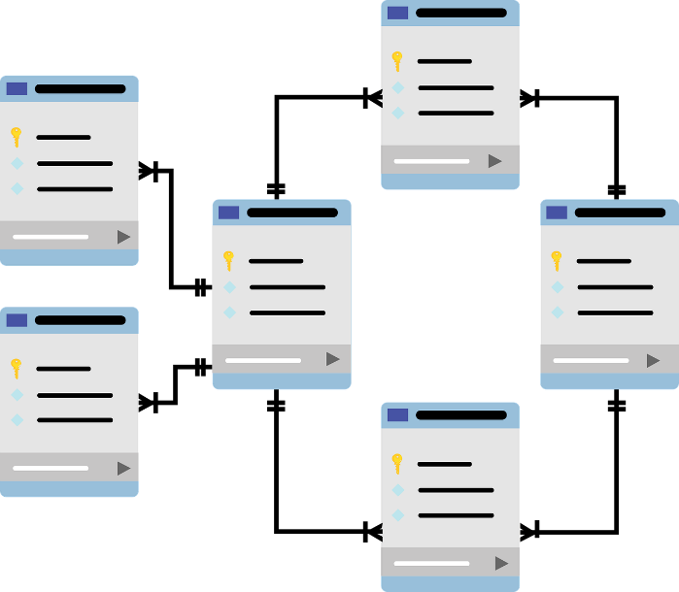
Data Collection & Database Design
1
Database schema
The Blueprint of the problem
Data-Type
2
Ensure Data Consistency
Access Control
3
Control access. Share the right data with the right person
Data Transferring
4
API connection

Slide 12
Reporting System
Increase Accuracy and Consistency
02
01
Decrease Latency
04
Reduce Human Error
03
Easy Access to Anyone

Slide 13
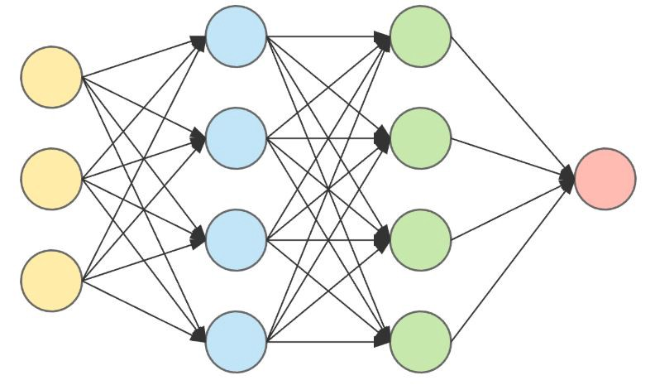
Predicting Modeling
1
Use statistics to predict outcomes
Algorithm
2
Data Quality
3
4

Slide 14
Part 3
Covid-19 Command Center

Slide 15

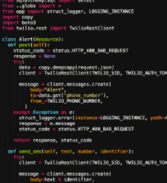

Covid-19 Command Center
Automated Data Center

Slide 16
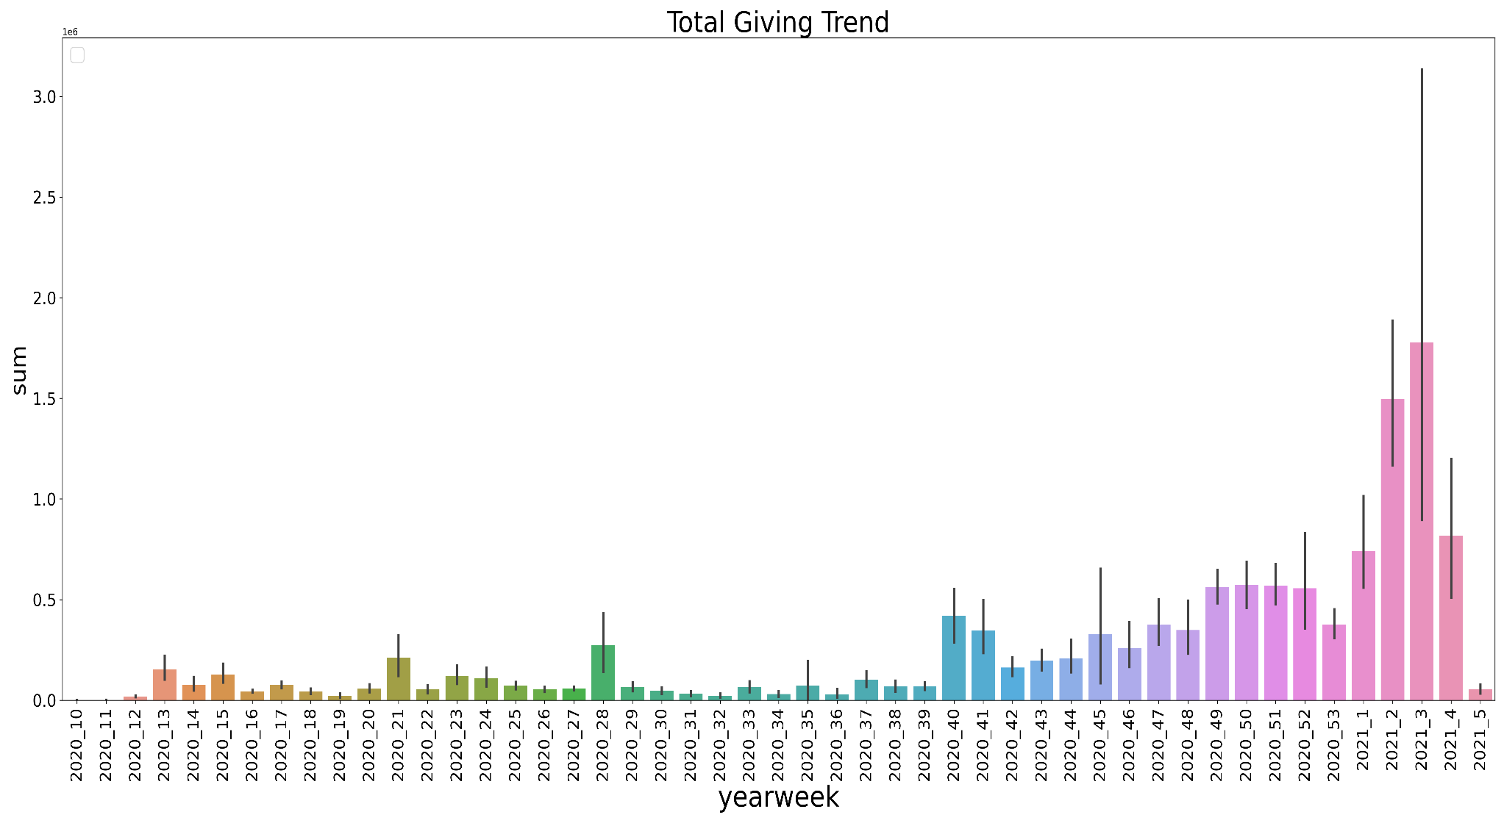
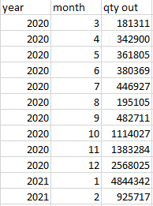

Slide 17
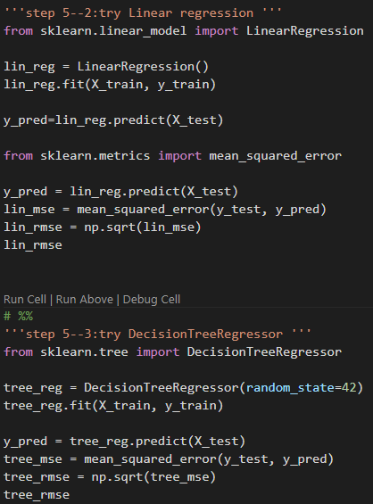
Covid-19 Machine Learning Prediction

Slide 18
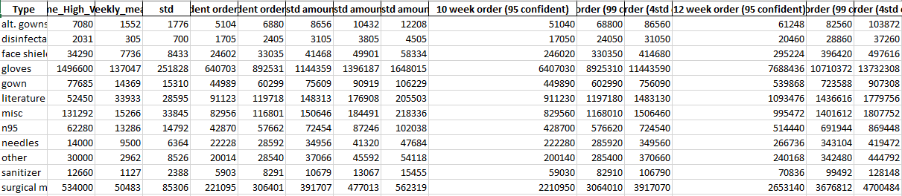
Covid-19 Six Sigma Prediction

Slide 19
Part 4
Summary
1
Osha KPIs
2
Data Project

Slide 20
Summary
Severity Rate
Incident Rate
Lost Workday Rate
A mathematical calculation that describes the number of lost days experienced as compared to the number of incidents experienced.
The is calculated by multiplying the number of recordable cases by 200,000, and then dividing that number by the number of labor hours at the company.
A mathematical calculation that describes the number of lost workdays per 100 full-time employees in any given time frame.

Slide 21
Summary
Problem Statement
Data Collection and Database Design
Monitoring with KPI
Reporting and Predicting

Slide 22
2021
Maricopa County – Risk Management
Thanks
Zixiang Michael Jin

